Slide 1
College Technical Math 1
Section 9.2, 19.4(1)
Graphing Linear Equations, Distance Formula

Slide 2
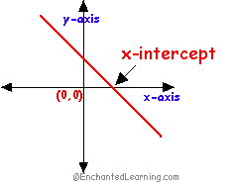
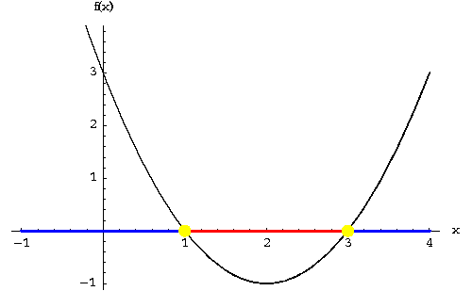
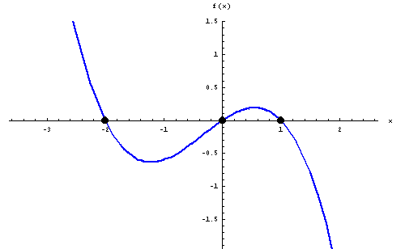
X - Intercepts
The x – intercept(s) of a graph are the points where the graph crosses the x – axis.
The y-coordinate of every x intercept is 0.
$$\left(x_{1}, 0\right) \left(x_{2}, 0\right) (x_{3}, 0)$$

Slide 3
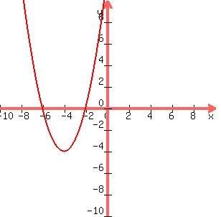
X - Intercepts
To determine the coordinates of the x-intercepts of a graph, simply identify the coordinates of the points located on the graph that lie on the x – axis.
Example:
$$(−6,0)$$
$$(−2,0)$$

Slide 4
X - Intercepts
To determine the coordinates of the x-intercepts of an equation:

Slide 5
X - Intercepts
To determine the coordinates of the x-intercepts of an equation:
1) Substitute a value of 0 for y in the equation.

Slide 6
X - Intercepts
To determine the coordinates of the x-intercepts of an equation:
1) Substitute a value of 0 for y in the equation.
2) Solve the resulting equation for x.

Slide 7
X - Intercepts
To determine the coordinates of the x-intercepts of an equation:
1) Substitute a value of 0 for y in the equation.
2) Solve the resulting equation for x.
3) Write the x intercept as $(x_{1},0)$

Slide 8
X - Intercepts
Determine the x intercept of $−3x+2y=12$ (Example)

Slide 9
X - Intercepts
Determine the x intercept of $−3x+2y=12$ (Example)
Substitute a 0 for y.
$$−3x+2\left(0\right)=12$$

Slide 10
X - Intercepts
Determine the x intercept of $−3x+2y=12$ (Example)
Substitute a 0 for y.
$$−3x+2\left(0\right)=12$$
Solve for x.
$$−3x+0=12$$
$$−3x=12$$
$$x=−4$$

Slide 11
X - Intercepts
Determine the x intercept of $−3x+2y=12$ (Example)
Substitute a 0 for y.
$$−3x+2\left(0\right)=12$$
Solve for x.
$$−3x+0=12$$
$$−3x=12$$
$$x=−4$$
Write the ordered pair.
$$(−4,0)$$

Slide 12
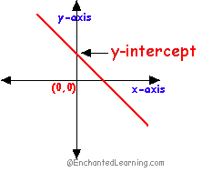
Y - Intercepts
The y – intercept of a graph are the points where the graph crosses the y – axis.
The graphs we will encounter will have at most one y intercept.
The x-coordinate of every y intercept is 0.
$$\left(0, y_{1}\right) \left(0, y_{2}\right) (0, y_{3})$$

Slide 13
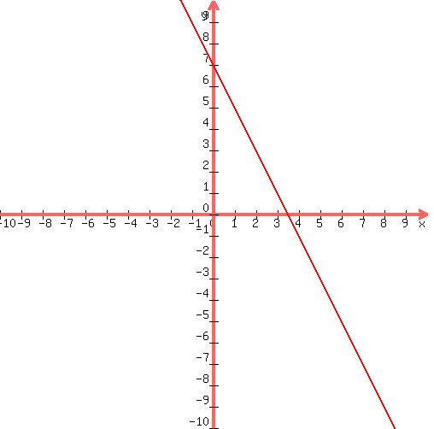
Y - Intercepts
To determine the coordinates of the y-intercept of a graph, simply identify the coordinates of the points located on the graph that lie on the y – axis.
Example:
$$(0,7)$$

Slide 14
Y - Intercepts
To determine the coordinates of the y-intercept of an equation:

Slide 15
Y - Intercepts
To determine the coordinates of the y-intercept of an equation:
1) Substitute a value of 0 for x in the equation.

Slide 16
Y - Intercepts
To determine the coordinates of the y-intercept of an equation:
1) Substitute a value of 0 for x in the equation.
2) Solve the resulting equation for y.

Slide 17
Y - Intercepts
To determine the coordinates of the y-intercept of an equation:
1) Substitute a value of 0 for x in the equation.
2) Solve the resulting equation for y.
3) Write the y intercept as $(0,y_{1})$

Slide 18
Y - Intercepts
Determine the y intercept of $−3x+2y=12$ (Example)

Slide 19
Y - Intercepts
Determine the y intercept of $−3x+2y=12$ (Example)
Substitute a 0 for x.
$$−3(0)+2y=12$$

Slide 20
Y - Intercepts
Determine the y intercept of $−3x+2y=12$ (Example)
Substitute a 0 for x.
$$−3(0)+2y=12$$
$$0+2y=12$$
Solve for y.
$$2y=12$$
$$y=6$$

Slide 21
Y - Intercepts
Determine the y intercept of $−3x+2y=12$ (Example)
Substitute a 0 for x.
$$−3(0)+2y=12$$
$$0+2y=12$$
Solve for y.
$$2y=12$$
$$y=6$$
Write the ordered pair.
$$(0,6)$$

Slide 22
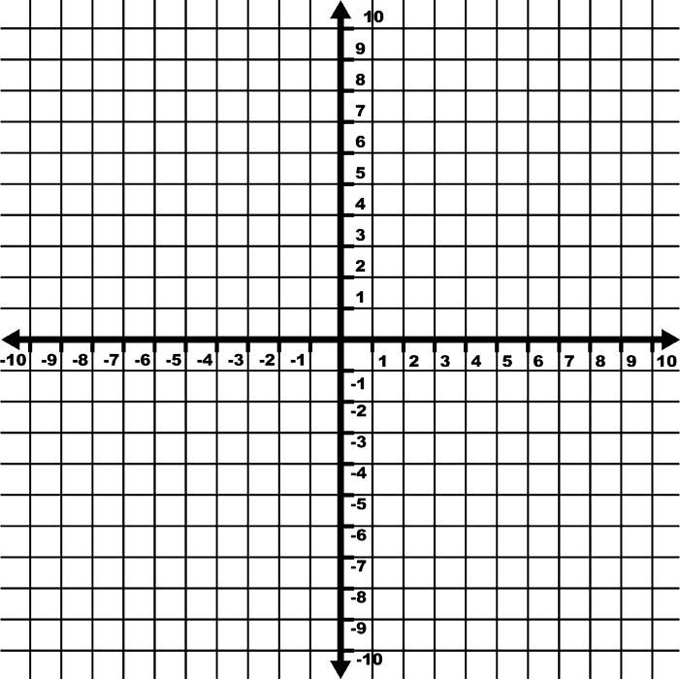
X and Y Intercepts
Using the x and y intercepts to graph an equation written in standard form, $Ax+By=C$, is a quick way to graph a linear equation.
y - intercept
x - intercept

Slide 23
X and Y Intercepts
Graph $−x+4y=8$ using the x and y intercepts. (Example)
x– intercept:
$$−x+4\left(0\right)=8$$
$$−x=8$$
$$x=−8$$
($−8,0)$

Slide 24
X and Y Intercepts
Graph $−x+4y=8$ using the x and y intercepts. (Example)
y– intercept:
$$−0+4y=8$$
$$4y=8$$
$$y=2$$
($0,2)$

Slide 25
X and Y Intercepts
Graph $−x+4y=8$ using the x and y intercepts. (Example)

Slide 26
X and Y Intercepts
What is the x-intercept of the equation $y=4x$?
$$x−int: (0,0)$$
What is the y-intercept of the equation $y=4x$?
$$y−int: (0,0)$$
If you plot these points you only have one point on the line. We need two!

Slide 27
X and Y Intercepts
What do we do?
Create a second ordered pair by choosing a value for x and then determine the corresponding value of y.
$$y=4x y=4\left(1\right) y=4 (1,4)$$

Slide 28
X and Y Intercepts
Graph $y=4x$ using the x and y intercepts. (Example)

Slide 29
Distance Formula
When points are plotted in a rectangular coordinate plane it is often desirable to determine the distance between the two points (length of the line segment connecting the points).
The distance formula is derived from the Pythagorean Theorem and is used to calculate this distance.

Slide 30
Distance Formula
The distance between two points $\left(x_{1},y_{1}\right)$ and $(x_{2}, y_{2})$ is calculated using the formula:
$$d=\sqrt{{\left(x_{2}−x_{1}\right)}^{2}+{\left(y_{2}−y_{1}\right)}^{2}}$$
Note: Both of the terms in under the radical will be positive and the distance, d, will also be positive.

Slide 31
Distance Formula
Calculate the distance between $(−3,1)$ and $(4,2)$. (Example)
$$d=\sqrt{{\left(x_{2}−x_{1}\right)}^{2}+{\left(y_{2}−y_{1}\right)}^{2}}$$
$$d=\sqrt{{\left(4−(−3)\right)}^{2}+{\left(2−1\right)}^{2}}$$
$$d=\sqrt{{\left(7\right)}^{2}+{\left(1\right)}^{2}}$$
$$d=\sqrt{49+1}$$
$$d=\sqrt{50}≈7.07$$

Slide 32
Distance Formula
Calculate the distance between $(9,4)$ and $(3,0)$. (Example)
$$d=\sqrt{{\left(x_{2}−x_{1}\right)}^{2}+{\left(y_{2}−y_{1}\right)}^{2}}$$
$$d=\sqrt{{\left(3−9\right)}^{2}+{\left(0−4\right)}^{2}}$$
$$d=\sqrt{{\left(−6\right)}^{2}+{\left(−4\right)}^{2}}$$
$$d=\sqrt{36+16}$$
$$d=\sqrt{52}≈7.21$$

